Slide 1
Application Demo & Progress Update
G7T2

Slide 2
1.
FUNCTIONALITIES

Slide 3
Adding Functionalities
Dropping Functionalities
Student: Showing the courses that the students have completed
Able to display enrolled courses and current bids in Dashboard timetable.
Log out, Go back
None at the moment

Slide 4
Completed Functionalities
Login (student & admin)
Bid for a section (student)
Drop a bid (student)
Bootstrap (admin)
Drop a section (student)
View bidding results (student)
Starting and clearing rounds (admin) Round 1
Note: Functionalities completed in Iter 2 are in red

Slide 5
Ip address 18.218.67.64
Login page: 18.218.67.64/app/login.php
Admin password: admin
Notes:
Give a title for this?

Slide 6
2.
SCHEDULE

Slide 7
Iteration 1 (16-29th Sept W5-W6)
Goals: Login Functionality + 1 additional function.
Milestones: PM review
Bootstrap and Data validation | Sherman-Yizhou
Bidding and login functionalities | Sue-Anne-Giles, Giles-Joshua, Sue-Anne-Joshua
As this is the first iteration, we were still feeling out the capabilities of our members. As such our pairings are quite fluid and we sometimes move members around as necessary.
All members would help to integrate the components during our weekly meetings.

Slide 8
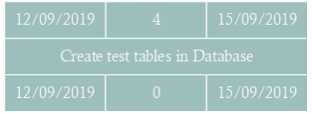
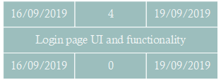
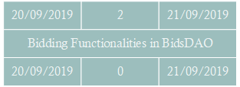
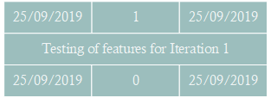
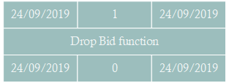
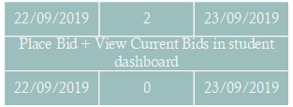
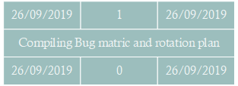
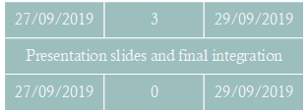
Critical Path (Iter 1)

Slide 9
Iteration 2 (30th Sept - 13th Oct W7-W8)
Goals: Working prototype, Improved estimation of schedule and critical path.
Milestone: App demo and progress update
Tasks overview:
Drop section functionality + Display Bidding results (Giles, Sherman)
Implementation of Json test cases + page securities (protect.php) ( Sherman + Joshua)
Setting of rounds by admin + Processing successful bids (Yizhou, Sueanne)

Slide 10
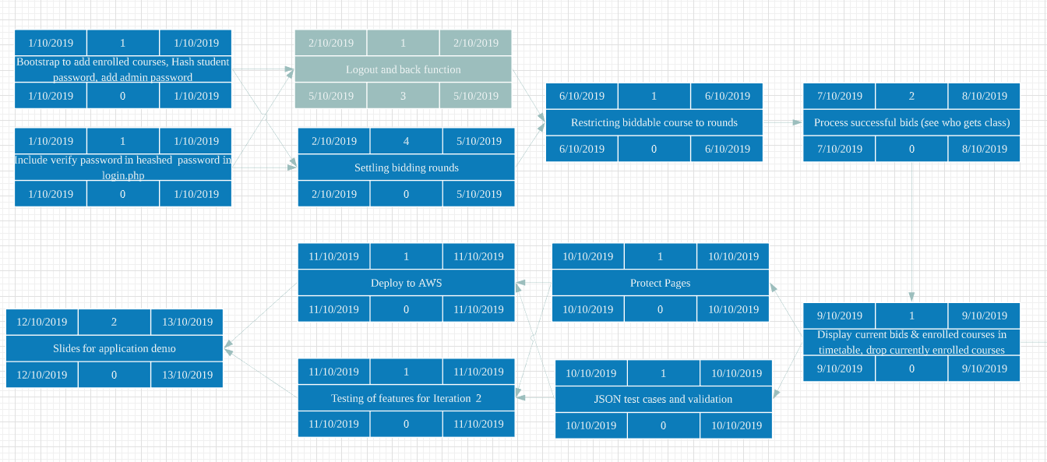
Critical path (Iter 2)

Slide 11
Iteration 3 (14th - 27th Oct W9-W10)
Goals: Ensure Application is ready, and deployable on AWS. All functionalities and test cases cleared.
Milestone: User Acceptance Test
Tasks overview:
Starting & Clearing round 2 (Sherman, Sueanne)
Cleanup and bug fixing (Sherman, Sueanne)
Integration of app + Create test cases (Joshua Yizhou)
Test locally and cloud (all)
Complete JSON files-start,stop,update bid (Joshua Yi zhou)

Slide 12
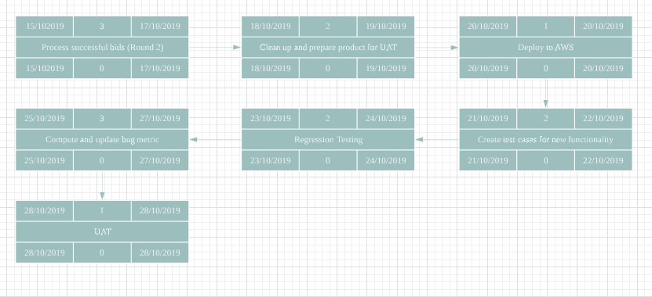
Critical Path (Iter 3) -Revised

Slide 13
Iteration 4 (28th Oct - 10th Nov W11-W12)
Goals: Revise prototype and bug fixing
Milestone: Integrated and revised version of application
Tasks overview:
Compile bugs in UAT, and revise application ( Giles, Sueanne)
Integration of changes and final test ( Joshua, Sherman )
Start on slides for Final Presentation( ALL )

Slide 14
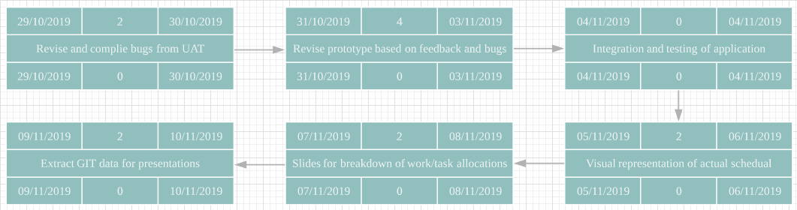
Planned Critical path (Iter 4) -No changes

Slide 15
Iteration 5 (11th Nov - 17th Nov W13)
Goals: Preparation of final presentation
Milestone: Final presentation
Tasks overview:
Data representation on slides- Git and Schedule (Joshua, sueanne)
Key takeaways and Bugs metric (yizhou , giles)
Rehearse for presentation ( All )

Slide 16
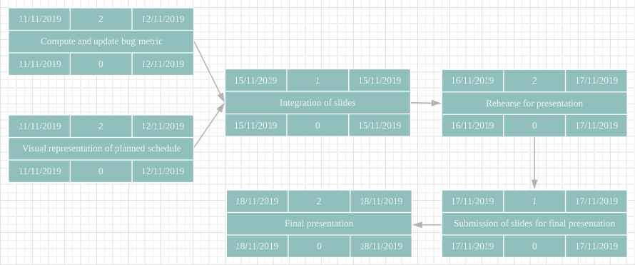
Planned Critical path (Iter 5) -Revised

Slide 17
3.
BUG METRICS
Notes:
Do we have to show our test cases and compare against expected output?

Slide 18
Bug Metrics (Iteration 1)
Bug points: 20
Function | Description | Severity | Points
Login (user) | Failed login with correct username and password | Low | 1
Bid for a section | "Available courses" column still shows courses that user has already bidded | High | 5
Bootstrap | Not displaying size of section accurately due to calling wrong variable | High | 5
Bootstrap | Calling session_start() twice in processfile.php | Low | 1
Bootstrap | Undefined offset warning due to explode function | Low | 1
Bootstrap | Various echo calls seen | Low | 1
Login (Admin) | Header redirect warnings | High | 5
Bootstrap | Cannot bid for sections with bidding amount which have decimal places | Low | 1

Slide 19
Bug Metrics (Iteration 2)
Bug points: 34
Function | Description | Severity | Points
Bootstrap | Upon deployment, bootstrap.php unable to successfully delete user-made temp folder | Critical | 10
Login (User) | When login attempt, fatal error message "table boss.adminstrator doesn’t exist" | High | 5
Starting and clearing rounds | No bidding money refunded to unsuccessful users | Low | 1
Bootstrap | Common.php calls for nonexistent table during app initialisation | Low | 1
Login (User) | For new user, unknown database 'boss' | Critical | 10
Bid for a section | Processbid Expected 5 Parameters, provided with 4 | Low | 1
Bid for a section | Accessing bidding page when round is closed by going to URL directly | Low | 1

Slide 20
Bug Metrics (Iteration 2)
Function | Description | Severity | Points
Bid for a section | Wrong error message when no sections are selected | Low | 1
Bid for a section | Enrolled 3 courses but still allowed to bid >=3 courses in next round | Low | 1
Bid for a section | When bidding for courses, it allows it to go through even though theres clashes with enrolled courses | Low | 1
Bootstrap | Able to start/close rounds even without bootstrapping | Low | 1
Bid for a section | Placing bids with clashed exam time return wrong error message "Clashed class time" | Low | 1

Slide 21
Bug Metrics
Total bug points: 54
Fixed: 53
Unfixed: 1

Slide 22
4.
ROLES & RESPONSIBILITIES
Pair programming teams & Rotation Plan

Slide 23
Rotation Plan for PM and pair programmers
 | PM | Coders/Pair Programmers
Iteration 1 | Sue-Anne | Sherman, Yizhou, Joshua, Giles
Iteration 2 | Joshua | Sherman, Giles, Yizhou, Sue-Anne, Joshua, Sherman (Recess week)
Iteration 3 | Giles | Sherman, Sue-Anne, Joshua, Yizhou
Iteration 4 | Yizhou | Giles, Sue-Anne, Sherman, Joshua
Iteration 5 | Sherman | Giles, Yizhou, Joshua, Sue-Anne

